Slide 1

Repurposing Diffusion-Based
Image Generators for
Monocular Depth Estimation
What is Marigold‘s innovation?
How to understand Marigold?
What is the role of diffusion modeling in?
How it compares with other depth estimation models?
Bingxin Ke

Slide 2


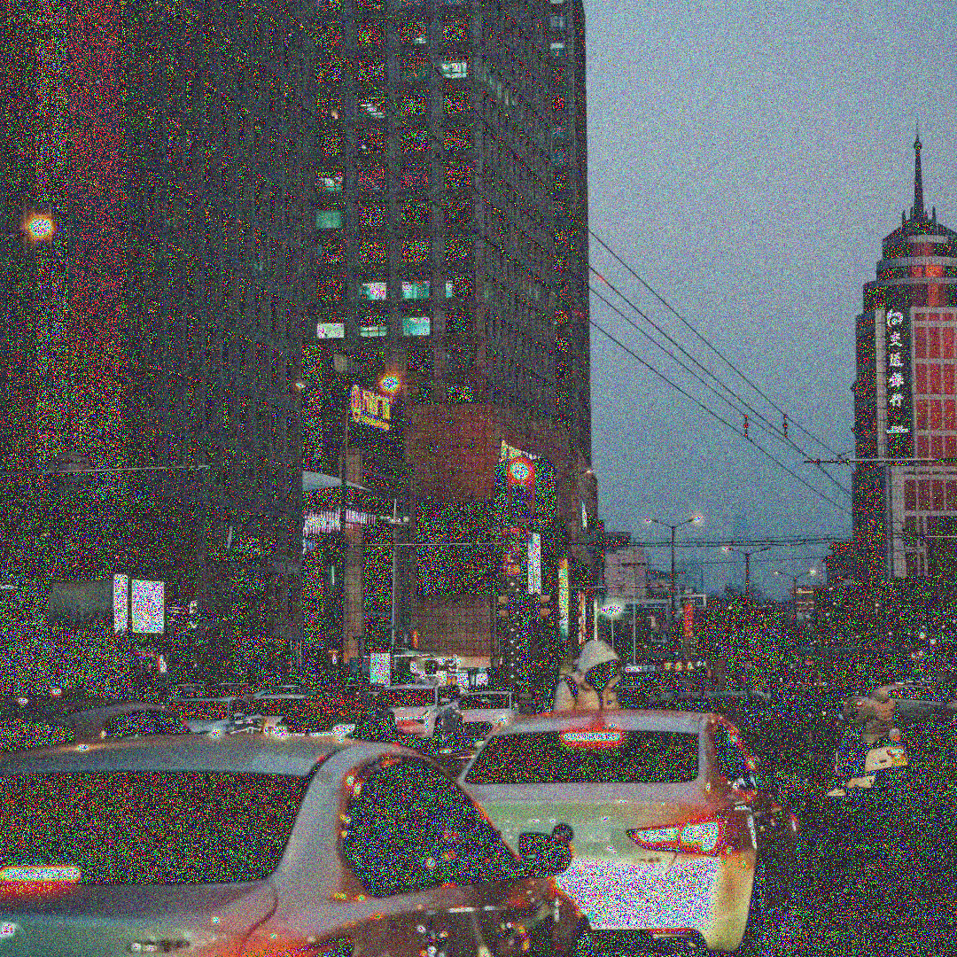
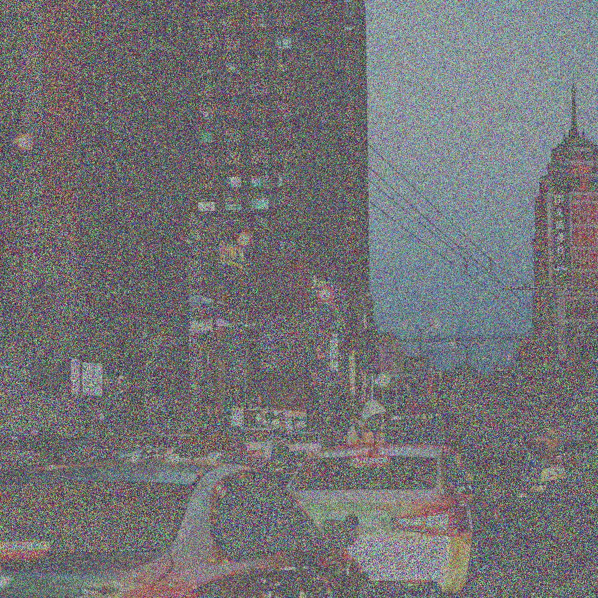


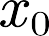
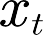

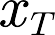



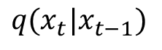
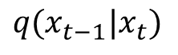
What is DDPM?
Markov
$$q(x_{t}|x_{t−1})$$
Data
Noise
+
+
Markov
$$q(x_{t−1}|x_{t})$$
Data
Noise
-
Model
（t）
Denoise Process

Slide 3
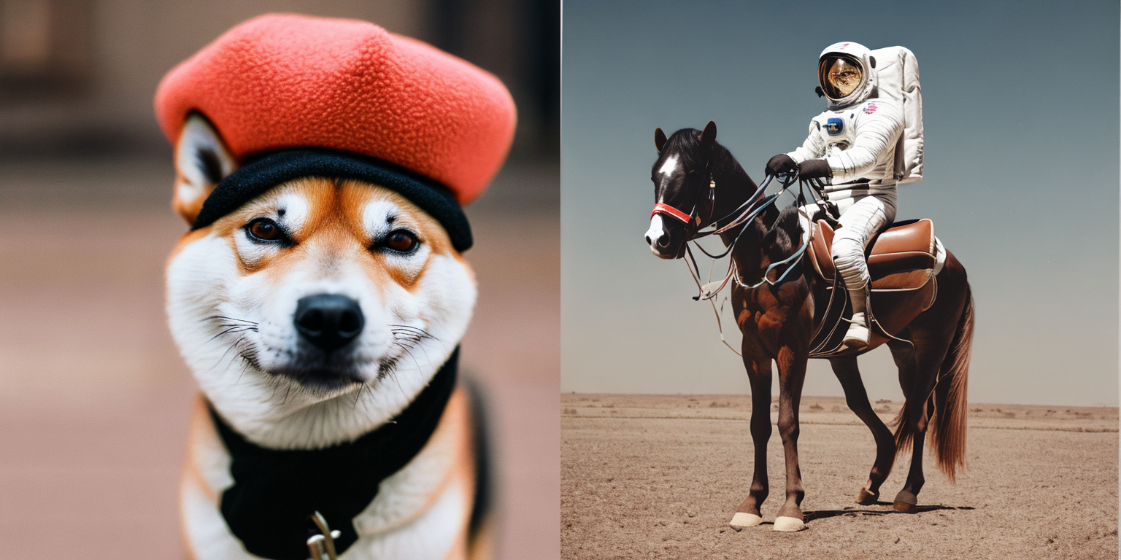
Stable Diffusion 2
Stable Diffusion 2（SD2）是由Stability AI于2022年发布的升级版文本生成图像（Text-to-Image）扩散模型，基于Latent Diffusion(LDM)架构，它可以通过文本描述（Prompt）生成高质量、高分辨率的图像（默认输出分辨率提升至768x768）
Stable Diffusion 2的训练数据进行了显著优化：
LAION-5B子集：基于LAION-5B（包含58.5亿图文对的开源数据集）筛选的高质量子集.
过滤掉NSFW内容、水印图像及艺术风格较低的样本.
使用CLIP模型筛选图文相关性高的数据.
数据多样性：涵盖更广泛的风格、文化和场景，生成结果更中立且多样化.
分辨率提升：训练数据包含更多高分辨率图像（≥768x768），支持更高清的输出.

Slide 4
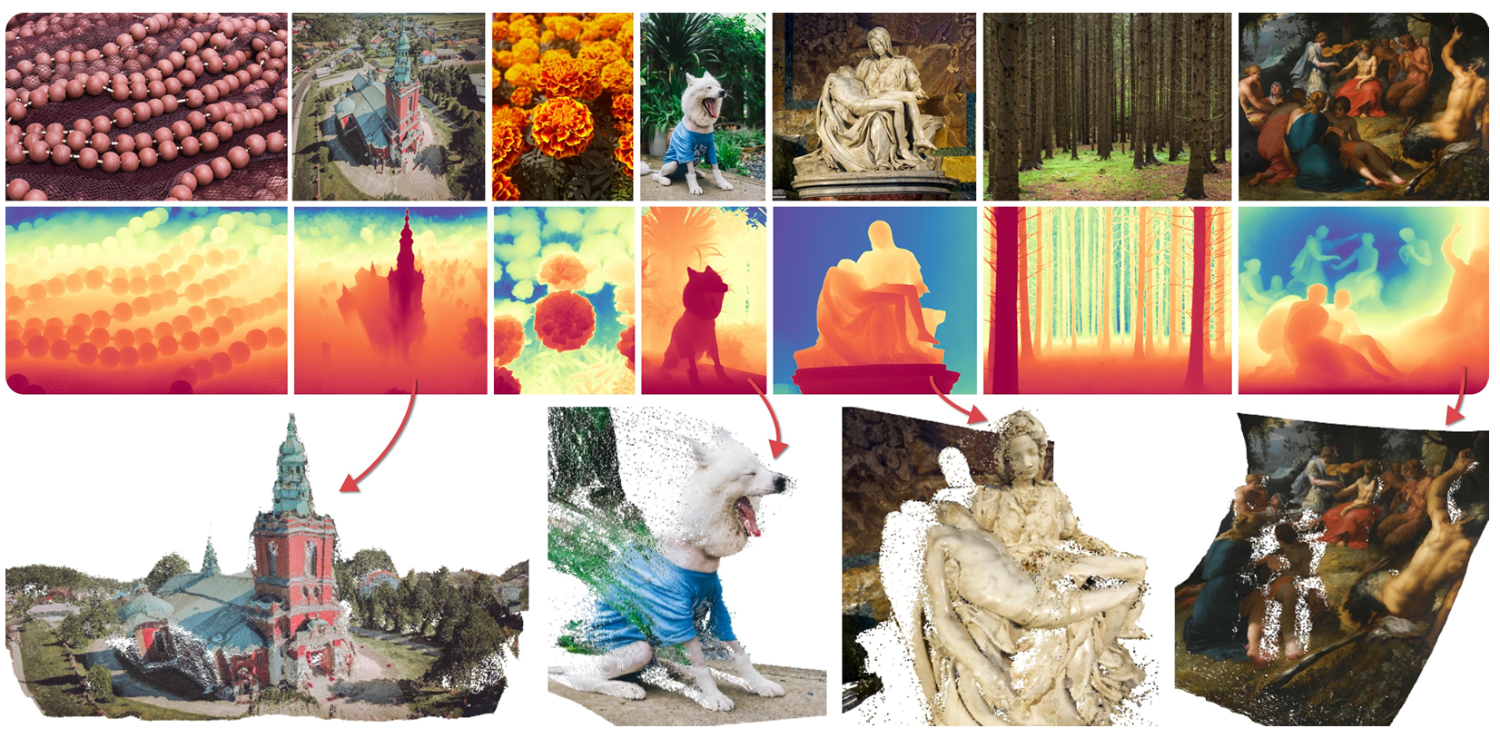
Marigold’s Innovation
Marigold的两个主要创新点都是与SD2有关：
I. 基于SD2进行改动，利用大型文本生成图像(Text-to-Image)扩散模型已经学习到的对于现实世界的表征，来进行深度估计.
II. 真实深度数据集普遍存在因采集设备物理限制和传感器特性导致的深度值缺失问题.本文仅采用合成深度数据集进行训练，因为合成深度数据本质上是密集且完整的，这意味着每个像素都具有有效的真实深度值，而不会因为相机之间的视差差异以及激光雷达光束在反射表面的偏转，从而引入单个像素的GT缺失.
We present Marigold, a diffusion model and associated fine-tuning protocol for monocular depth estimation. Its core principle is to leverage the rich visual knowledge stored in modern generative image models. Our model, derived from Stable Diffusion and fine-tuned with synthetic data, can zero-shot transfer to unseen datasets, offering state-of-the-art monocular depth estimation results.

Slide 5
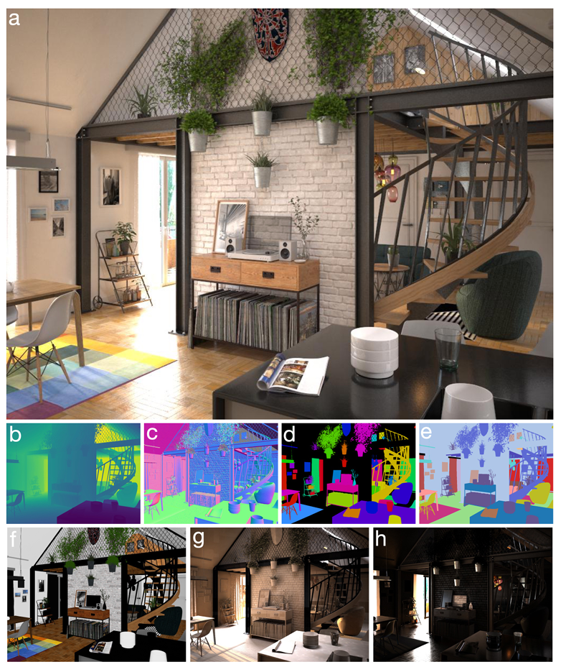
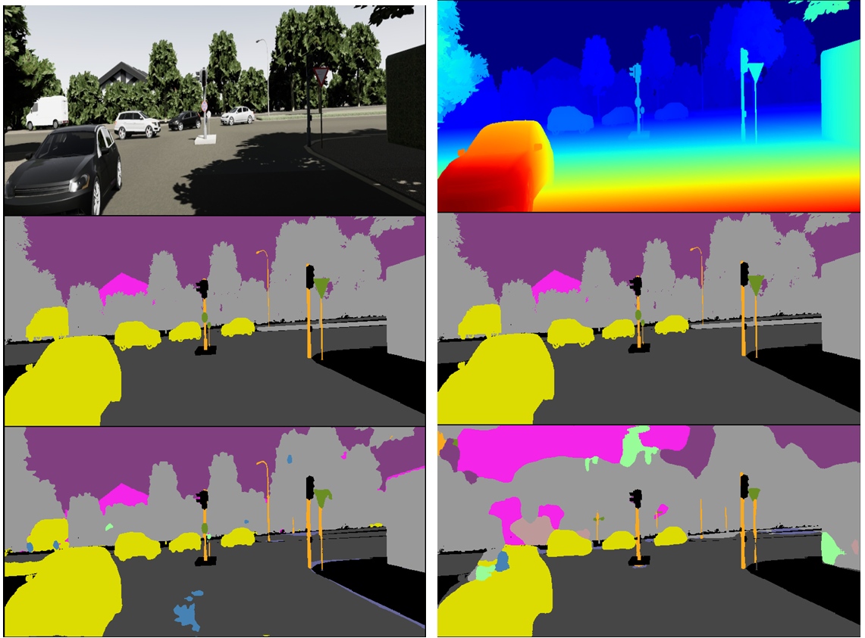
Synthetic datasets
Overview of the Hypersim dataset(1.9TB)
Overview of the Virtual Kitti dataset(7GB)

Slide 6
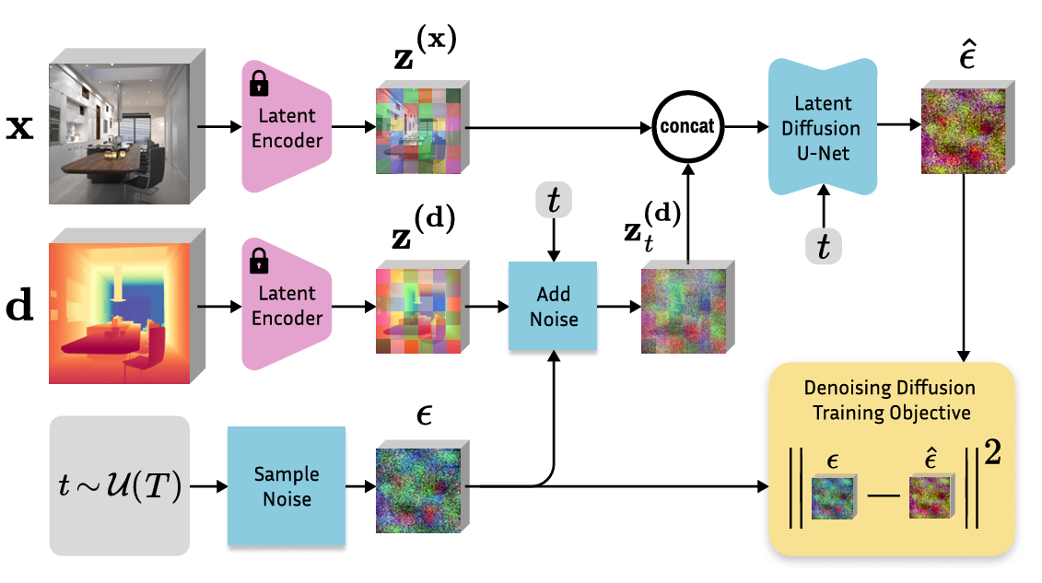
Overview of the Marigold fine-tuning protocol

Slide 7
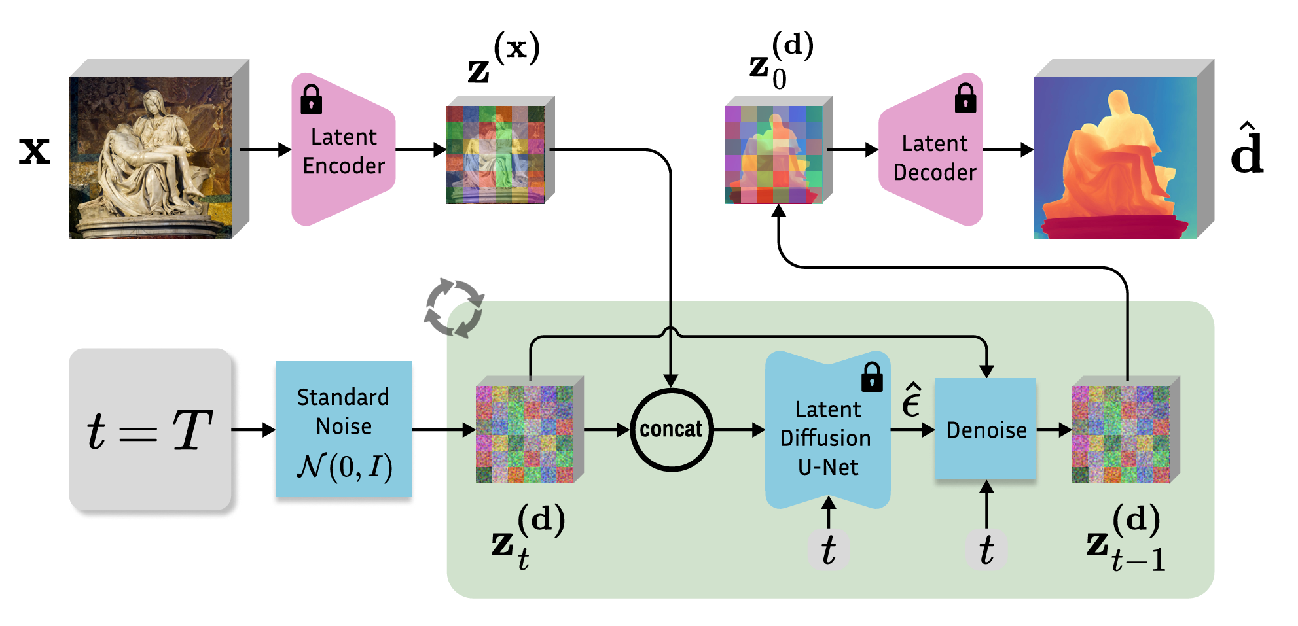
Overview of the Marigold inference scheme

Slide 8

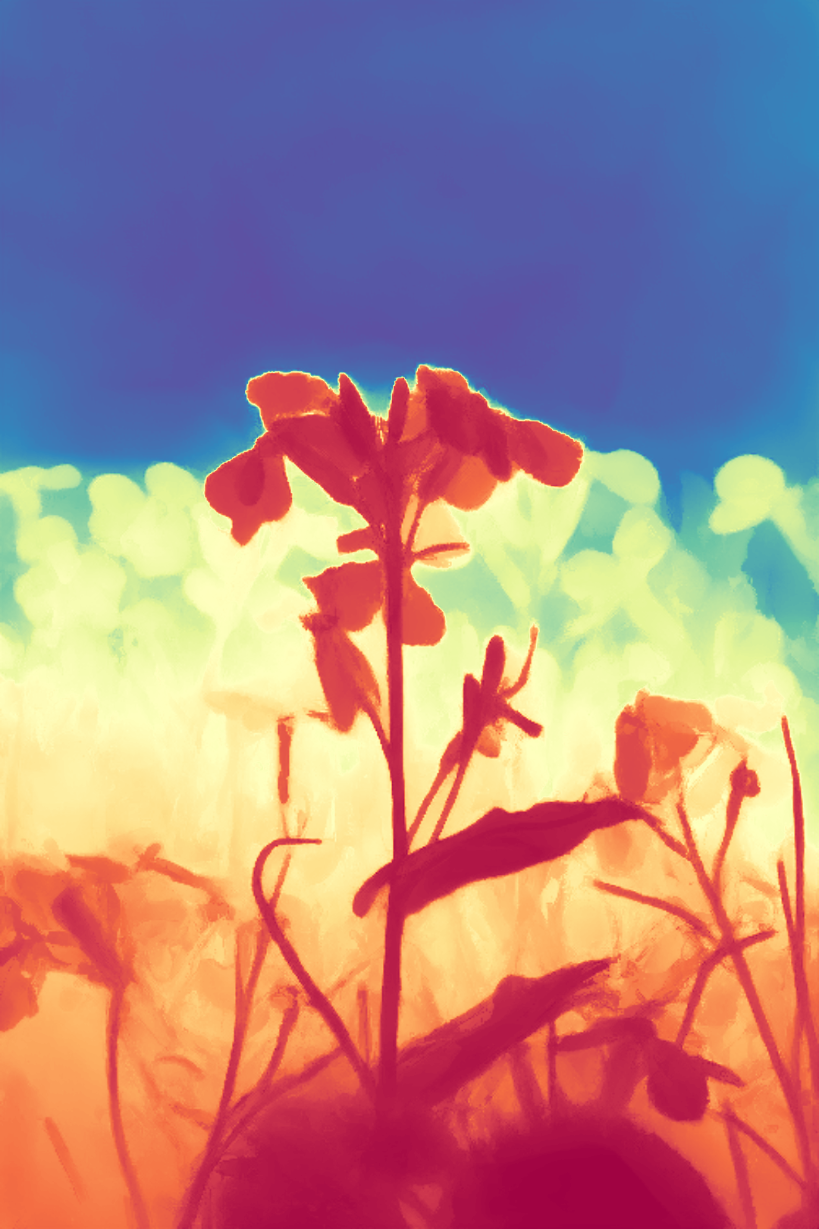
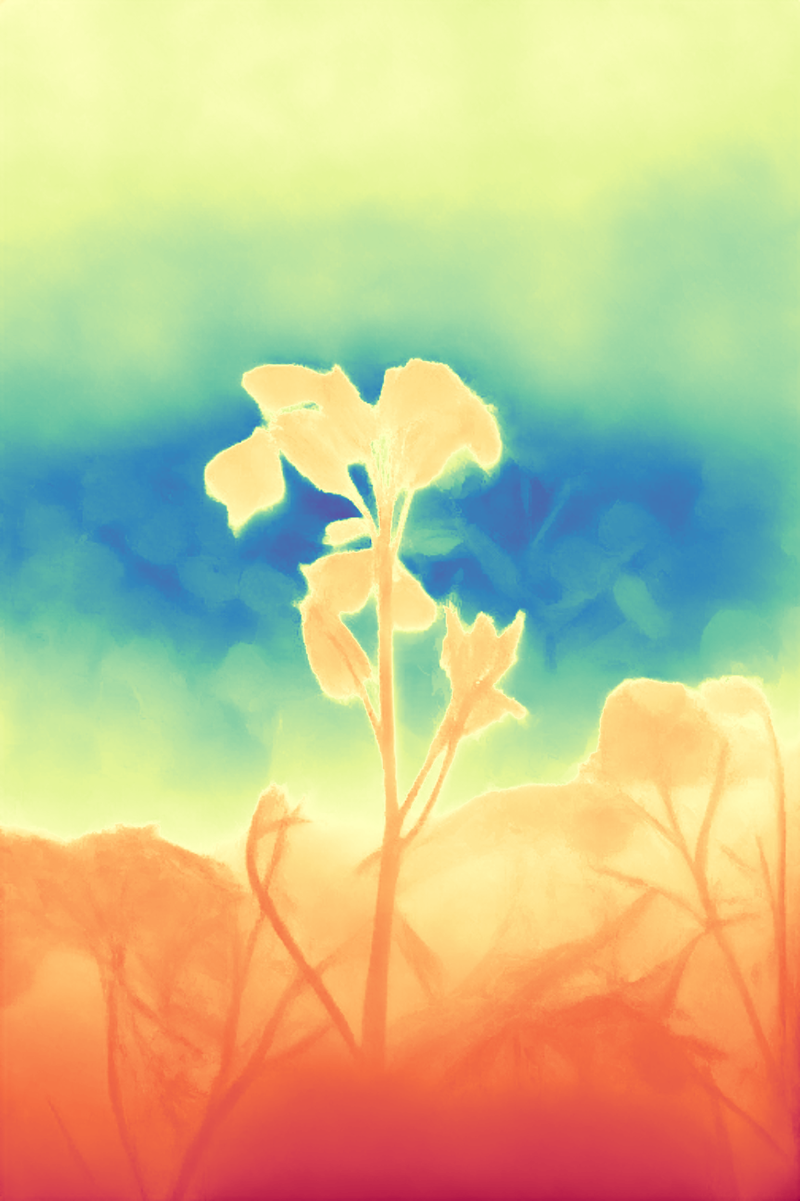
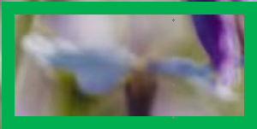



Result of Marigold
17 epochs
10000 iters
vkitti only
Image
Marigold
Trained model
Distill Any Depth

Slide 9
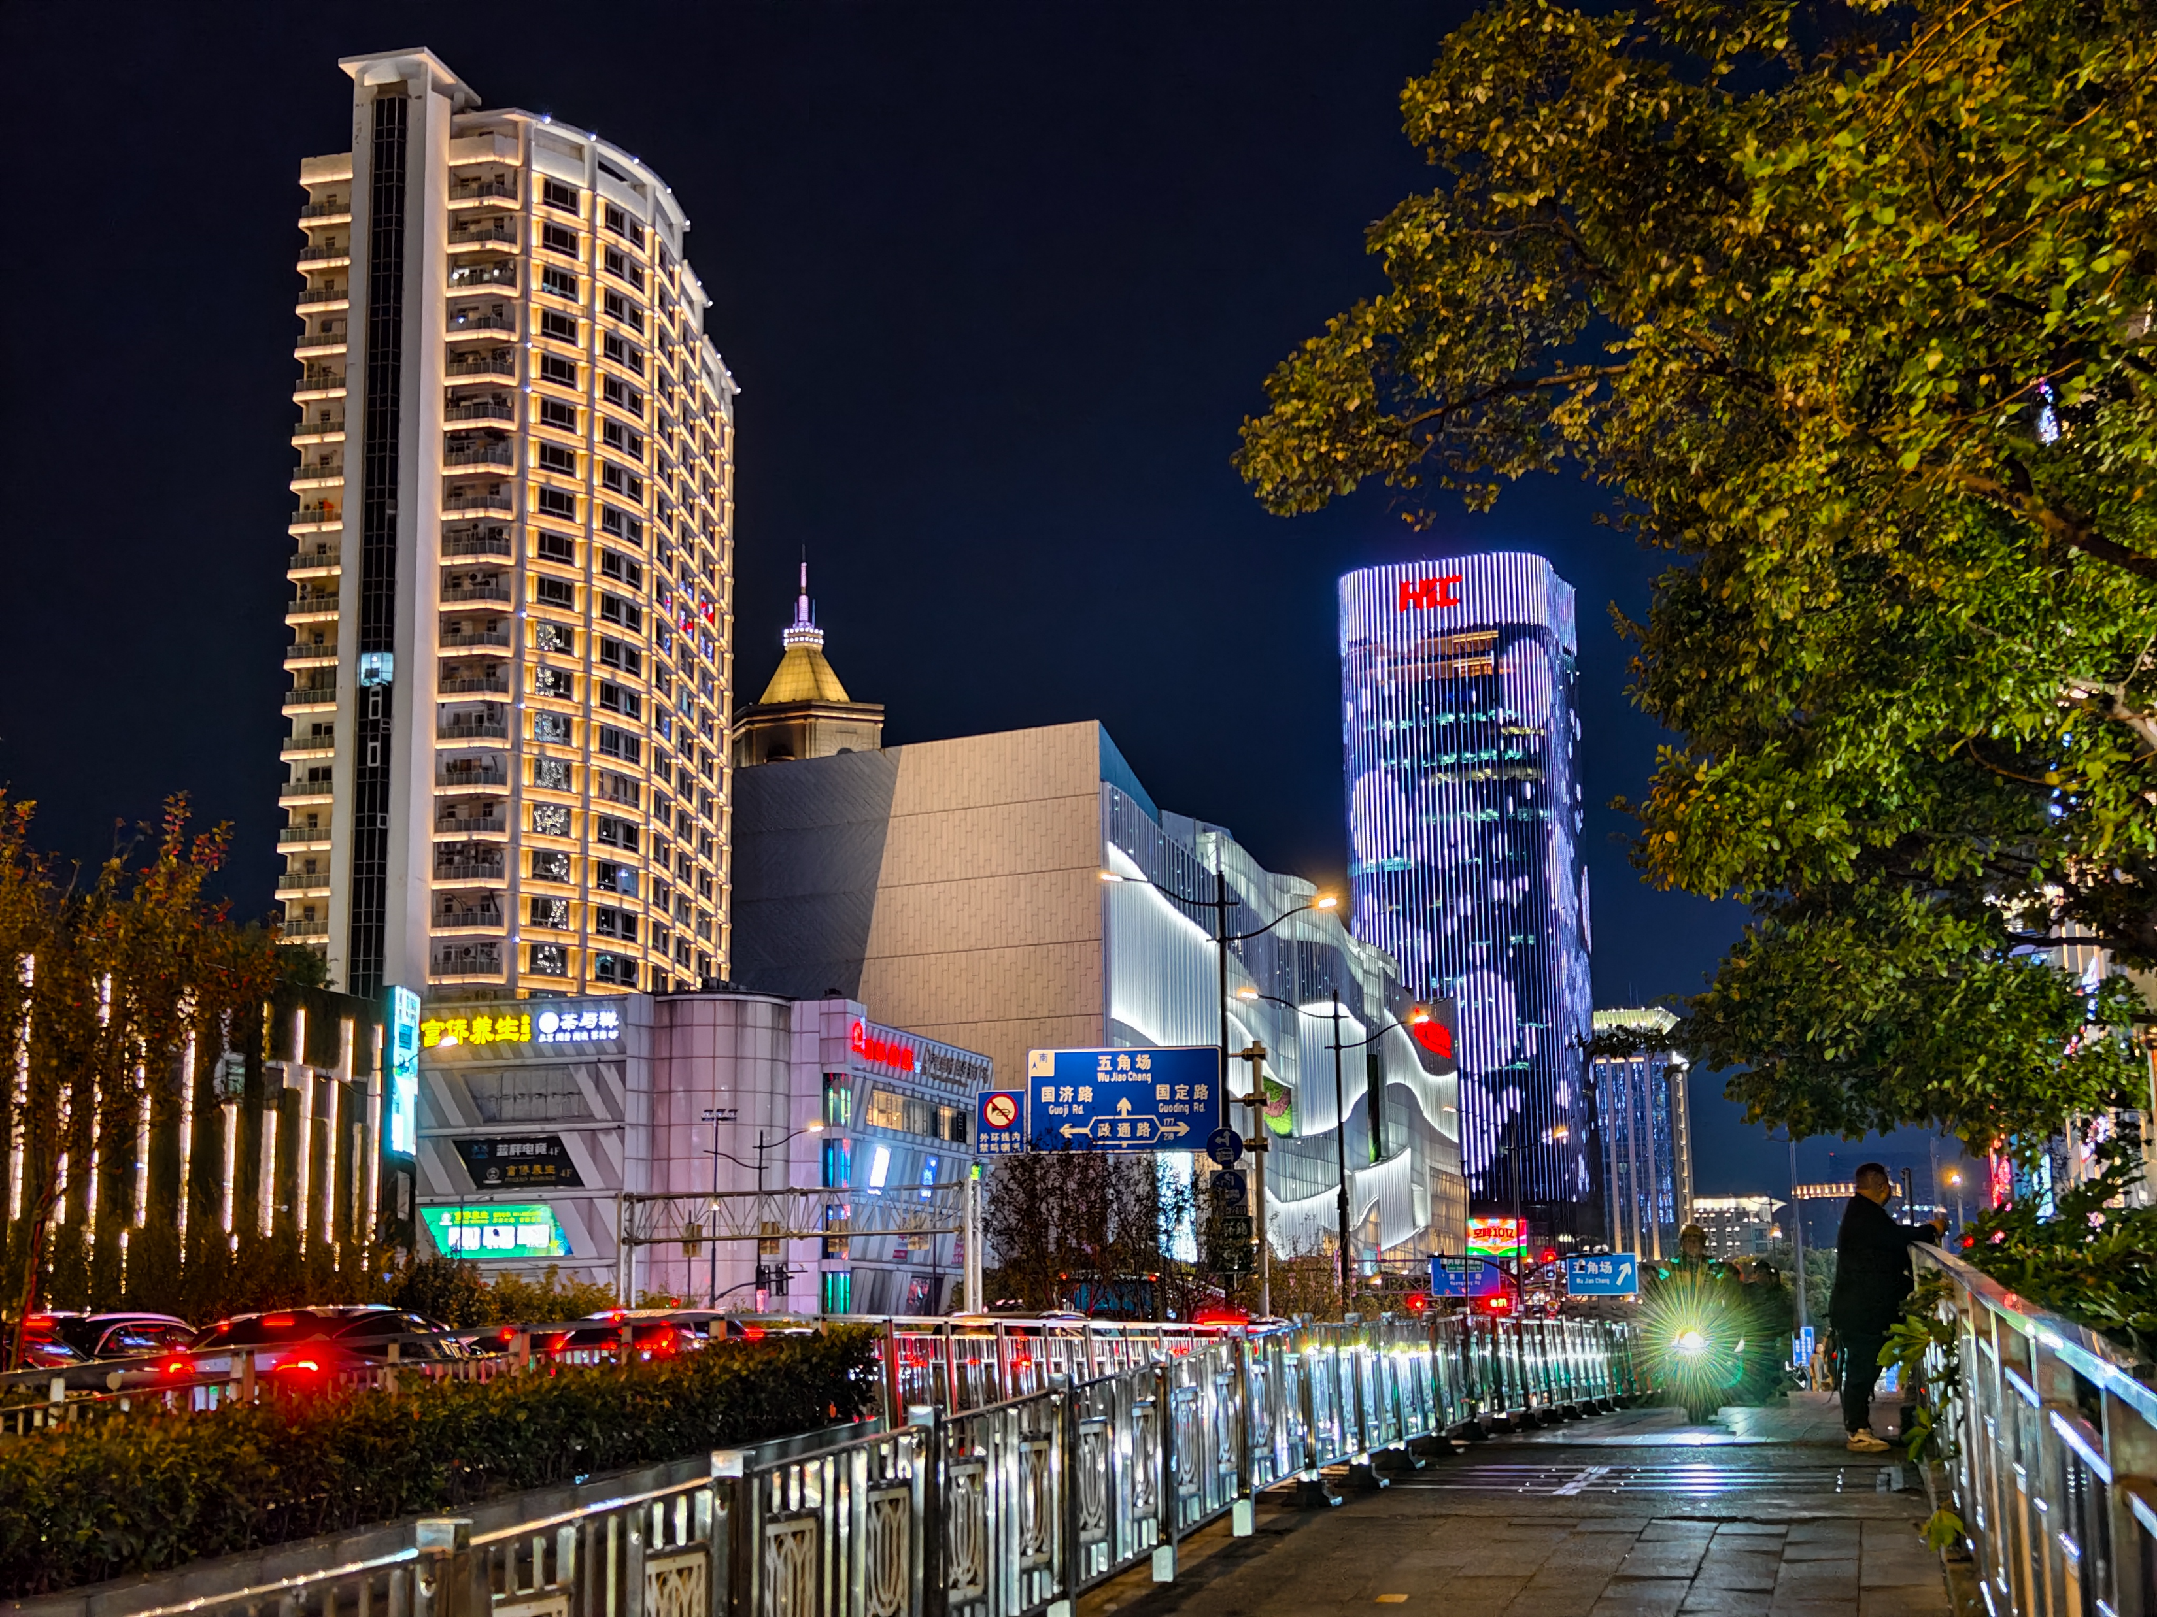
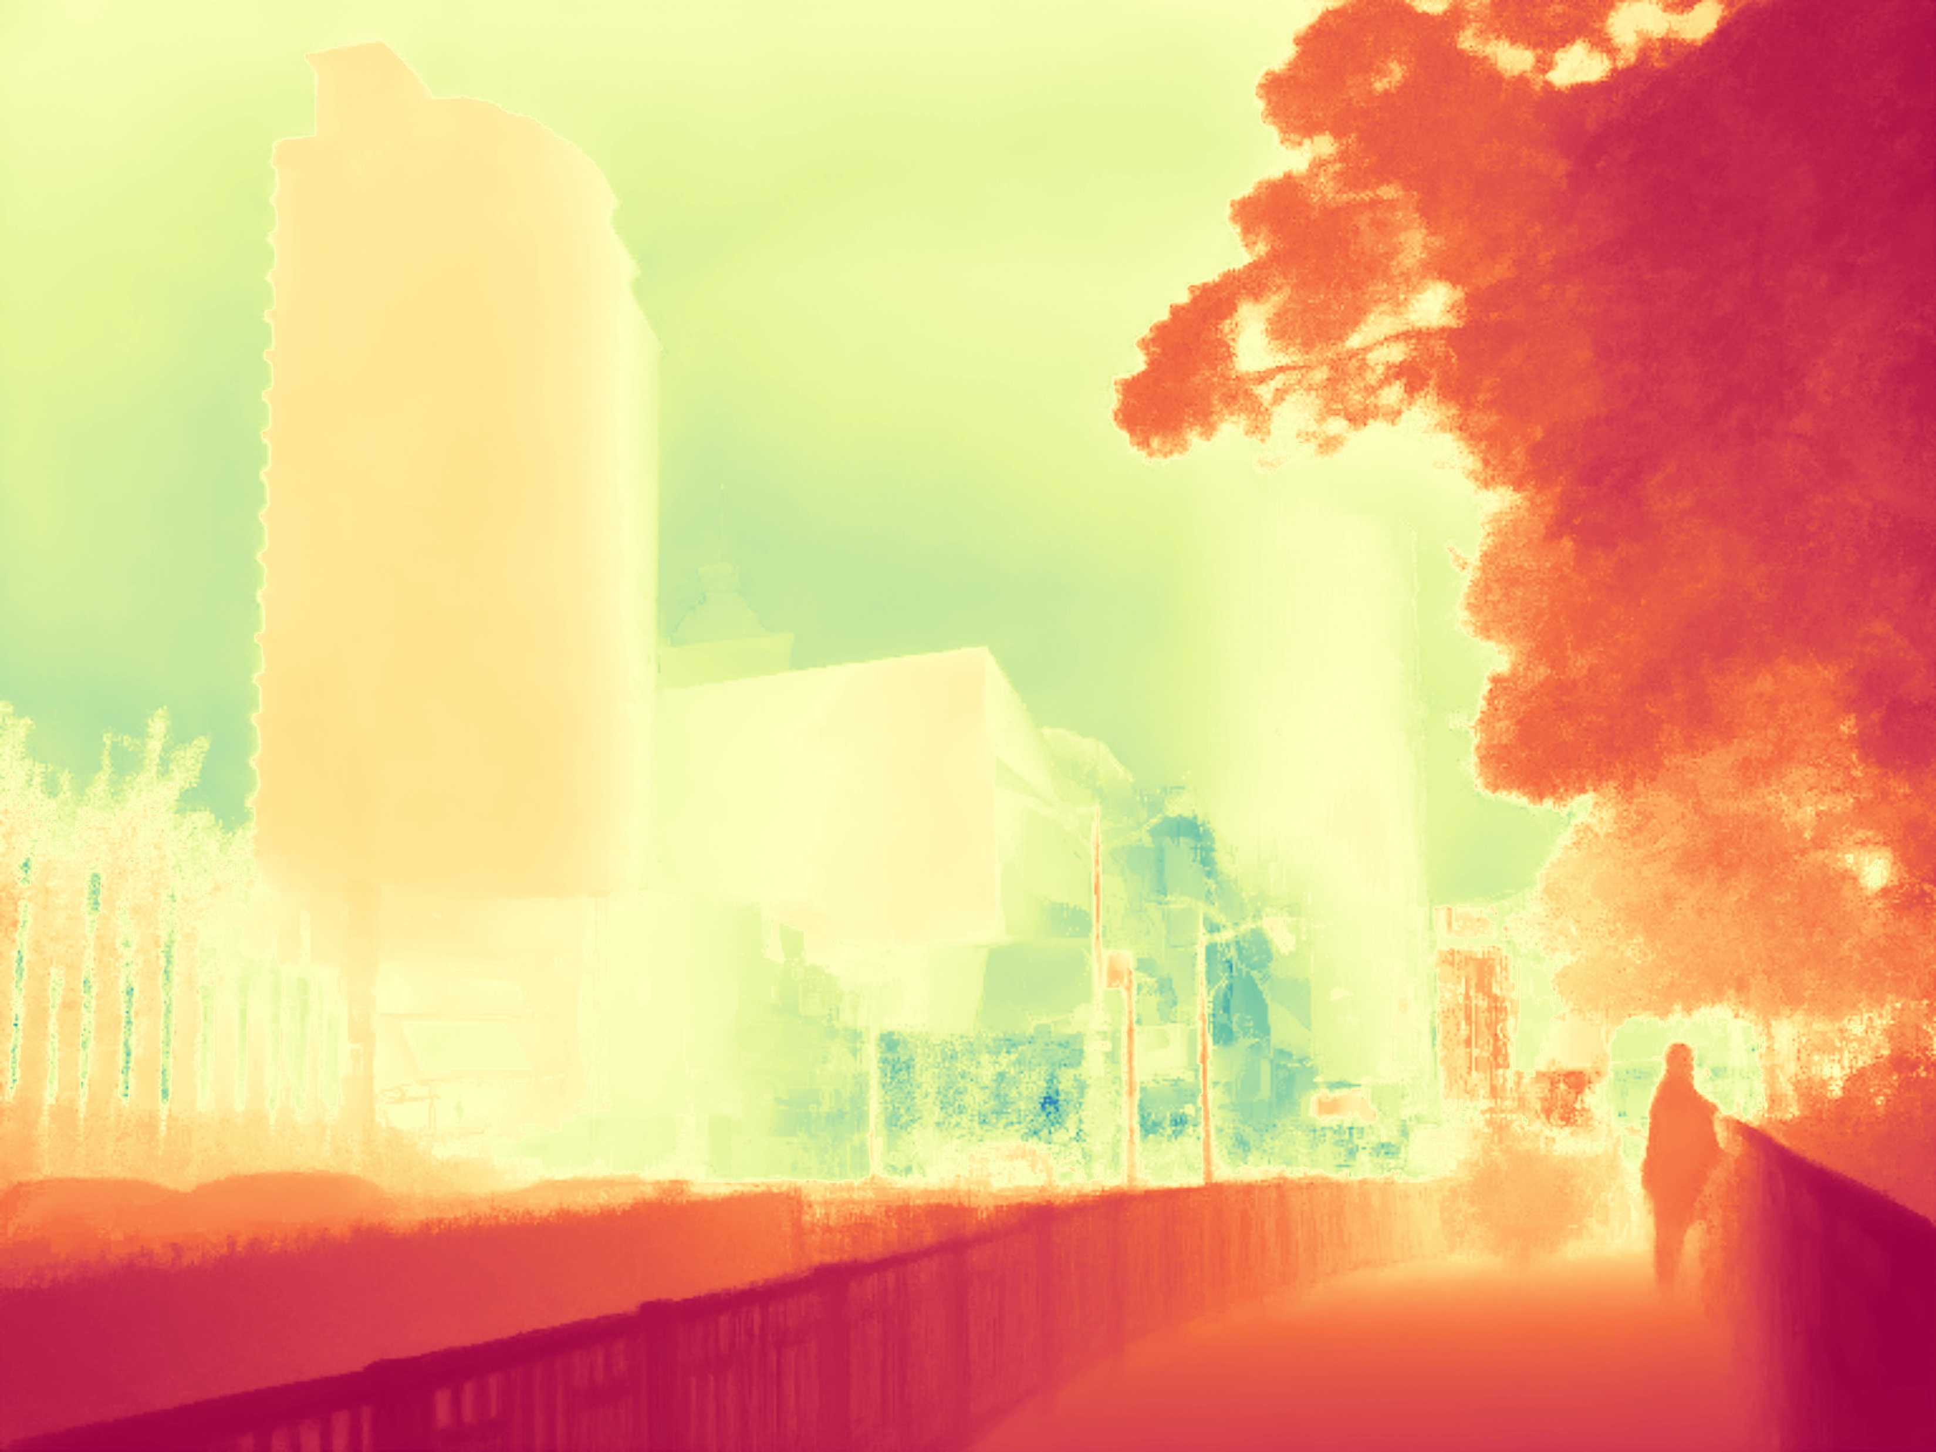
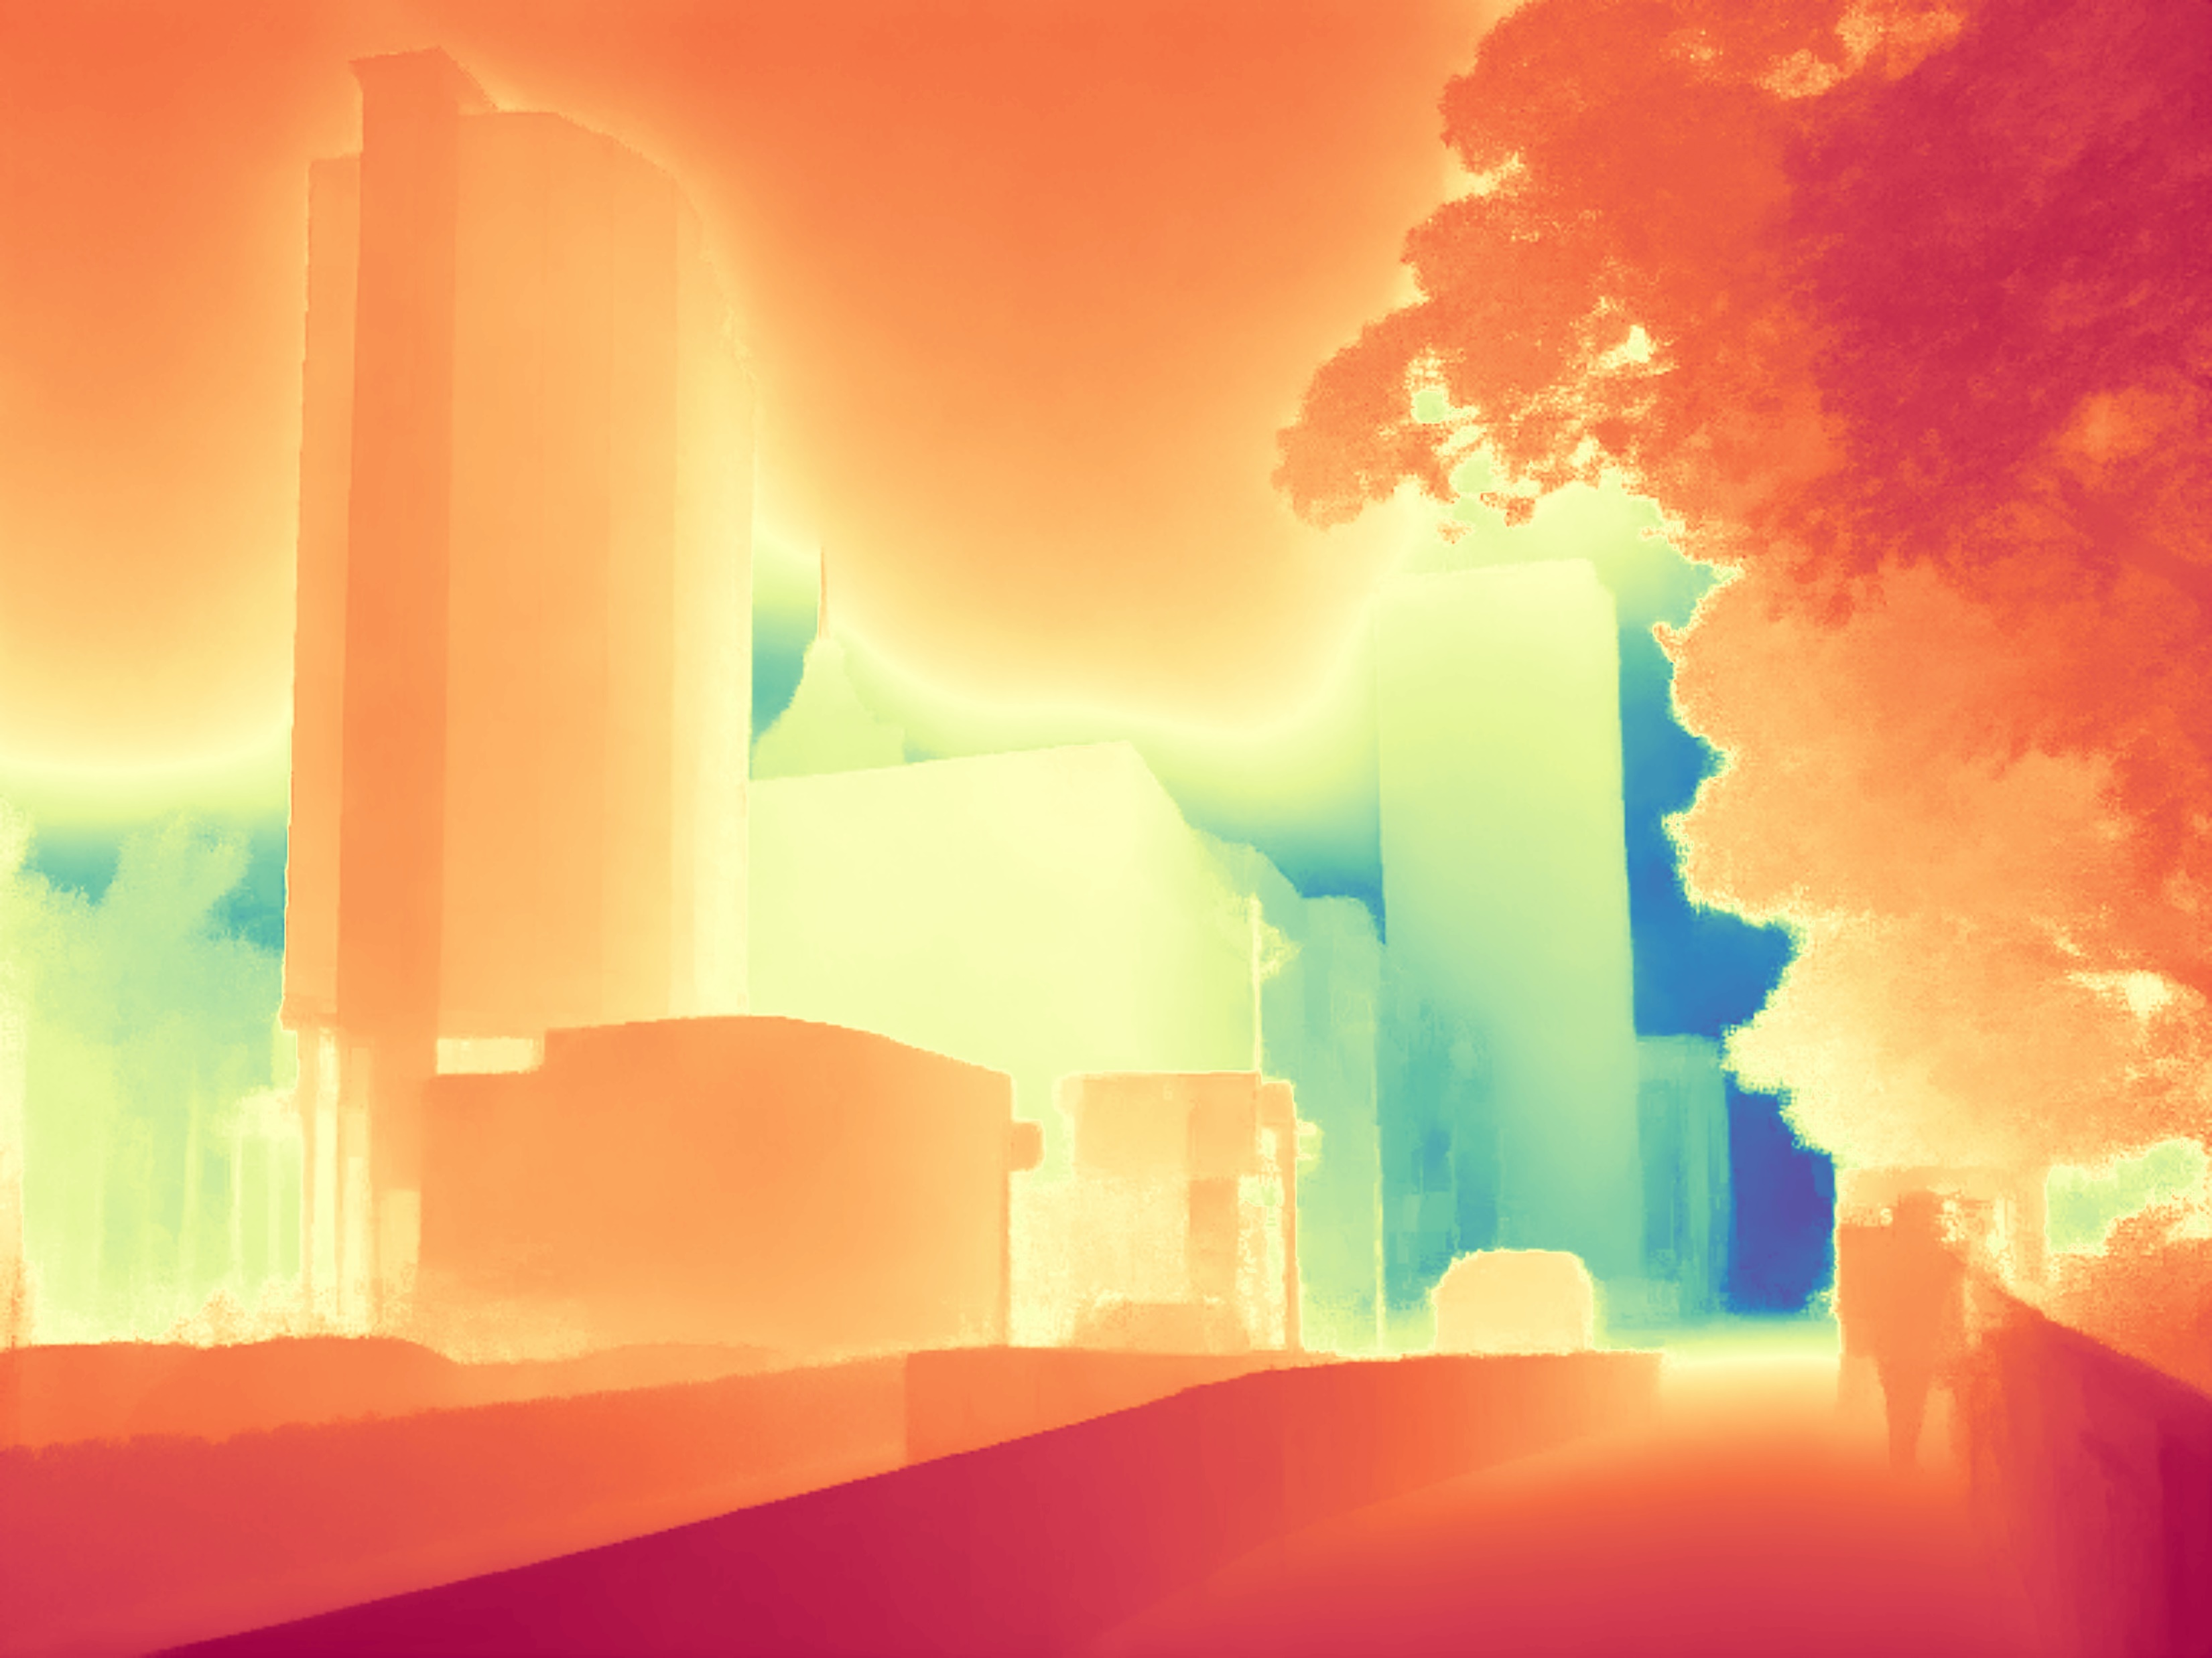
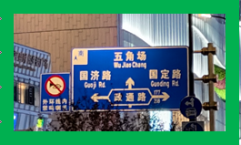

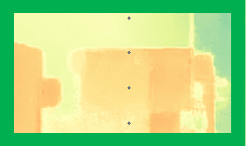

Result of Marigold-Outdoor
17 epochs
10000 iters
vkitti only
Image
Marigold
Trained model
Distill Any Depth

Slide 10
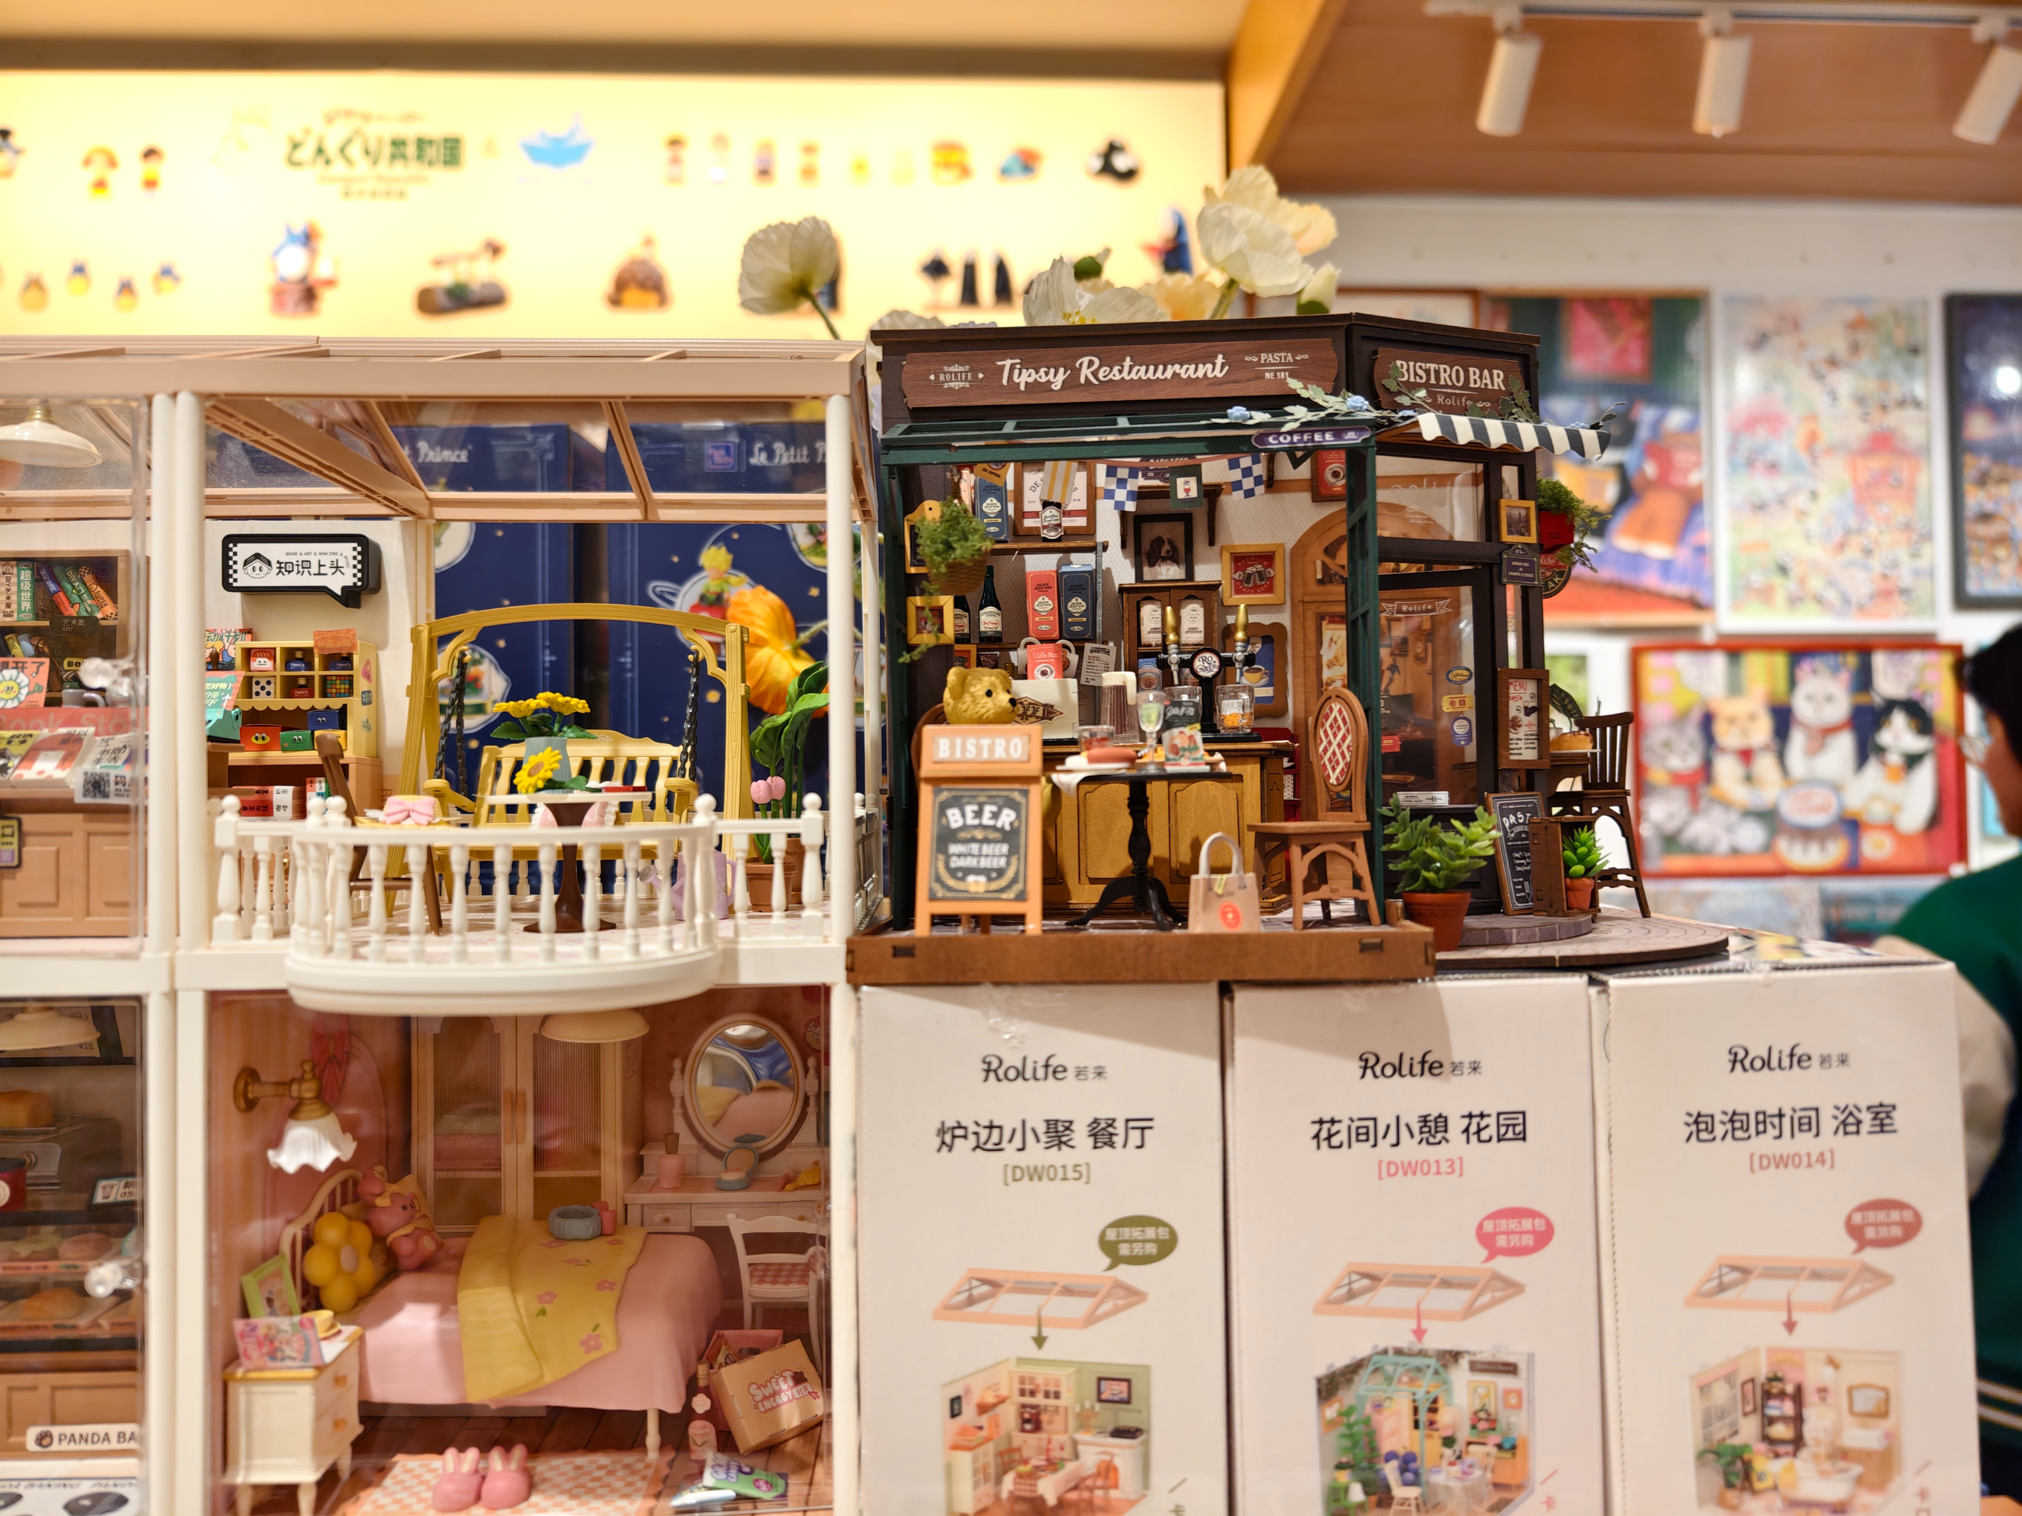
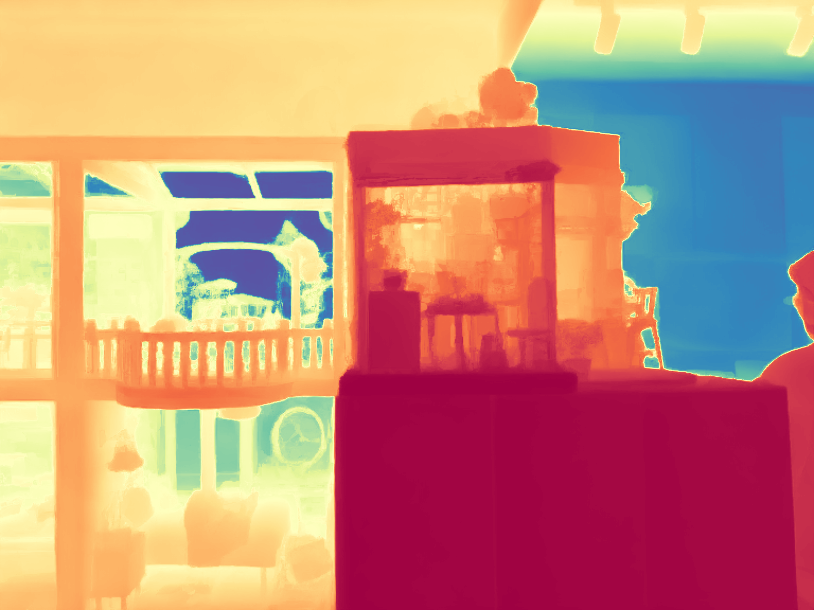
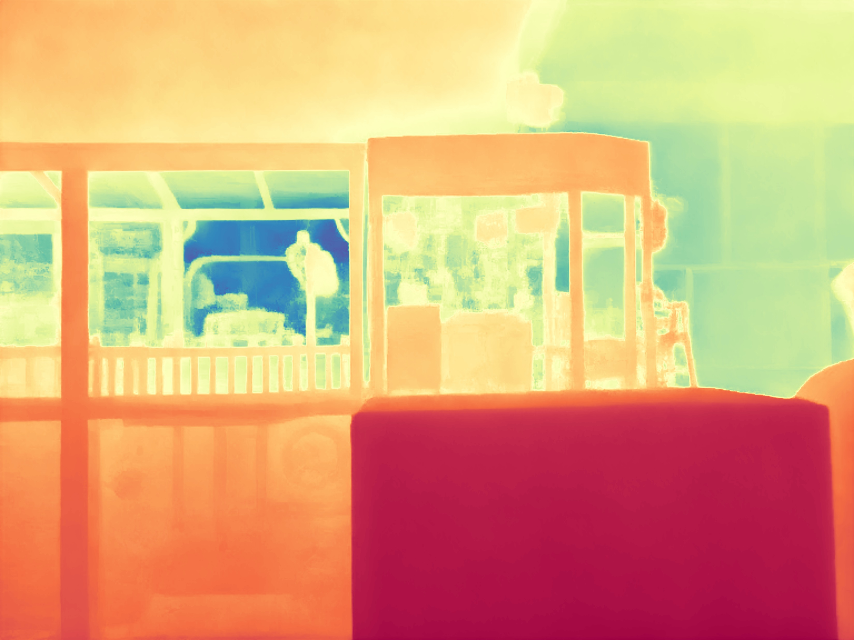
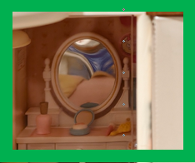


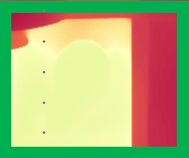
Result of Marigold-Indoor
17 epochs
10000 iters
vkitti only
Image
Marigold
Trained model
Distill Any Depth

Slide 11
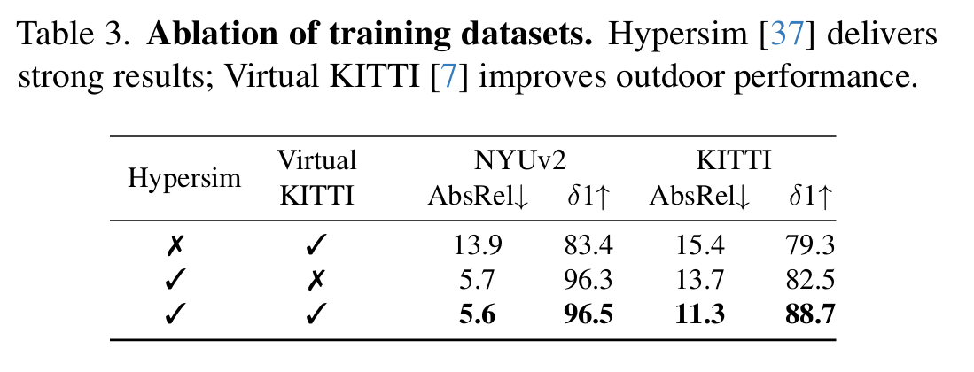
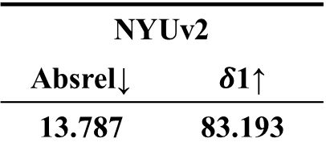
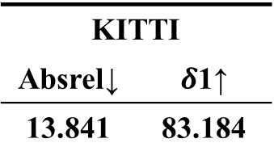
Quantitative comparison—Trained vs Marigold
NYUv2
Absrel↓ | $δ$1↑
13.787 | 83.193
KITTI
Absrel↓ | $δ$1↑
13.841 | 83.184

Slide 12
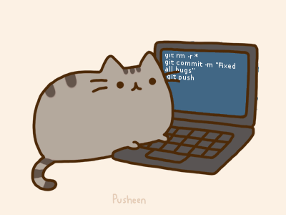
The end
Reference:
Ke B, Obukhov A, Huang S, et al. Repurposing diffusion-based image generators for monocular depth estimation[C]//Proceedings of the IEEE/CVF Conference on Computer Vision and Pattern Recognition. 2024: 9492-9502.Duan Y, Guo X, Zhu Z.
Rombach R, Blattmann A, Lorenz D, et al. High-resolution image synthesis with latent diffusion models[C]//Proceedings of the IEEE/CVF conference on computer vision and pattern recognition. 2022: 10684-10695.
Peebles W, Xie S. Scalable diffusion models with transformers[C]//Proceedings of the IEEE/CVF international conference on computer vision. 2023: 4195-4205.
Ho J, Jain A, Abbeel P. Denoising diffusion probabilistic models[J]. Advances in neural information processing systems, 2020, 33: 6840-6851.
Contact:
E-mail: Haruko386@outlook.com
Github: github.com/Haruko386
Training live show:
Wandb: https://wandb.ai/jw34617-shenyang-jianzhu-university/marigold/runs/vhifgqg7?nw=nwuserjw34617

